Slide 1


COVID-19 Analysis With SQL
Mentorness Internship Project
By Bilal BOUDJEMA

Slide 2

A PICTURE IS WORTH A THOUSAND WORDS

Slide 3
TABLE OF CONTENTS
01
02
Project Overview
Dataset Description
03
04
Analysis ( Queries )
Summary

Slide 4
Project Overview
The COVID-19 pandemic has profoundly affected public health, highlighting the pressing necessity for data-driven analysis to comprehend its transmission patterns.
As a data analyst, my assignment involves delving into a COVID-19 dataset to extract valuable insights and deliver your conclusions.

Slide 5
Dataset Description
Column Descriptions in the Dataset:
Province: A geographic division within a country or region.
Country/Region: The geographical entity where the data is documented.
Latitude: The north-south position on the Earth's surface.
Longitude: The east-west position on the Earth's surface.
Date: The recorded date of the COVID-19 data.
Confirmed: The count of diagnosed COVID-19 cases.
Deaths: The tally of COVID-19 related fatalities.
Recovered: The number of individuals who have recuperated from COVID-19.

Slide 6
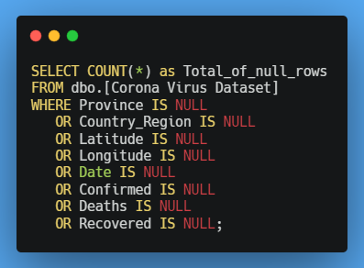
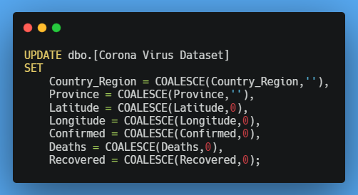

Data Exploration and Analysis
Checking for NULL Values
Checking for NULL Values

Slide 7
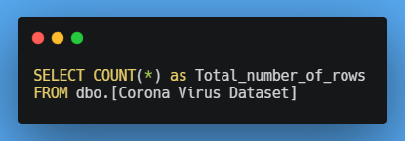

Data Exploration and Analysis
Check the total number of rows

Slide 8
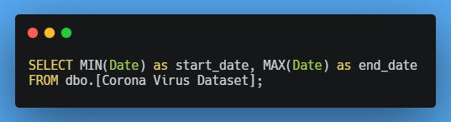

Data Exploration and Analysis
Check what is the start date and end date

Slide 9
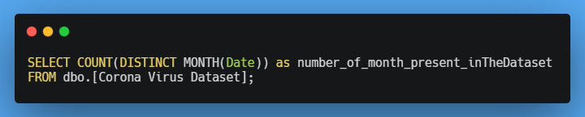

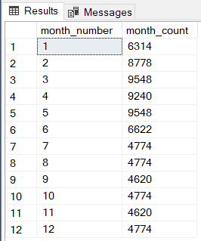
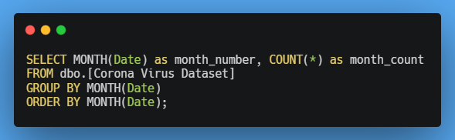
Data Exploration and Analysis
Check number of months in the dataset

Slide 10
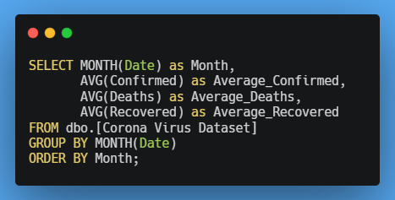
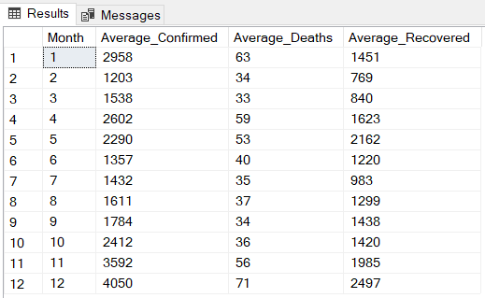
Data Exploration and Analysis
Find the monthly average for confirmed, deaths, recovered

Slide 11
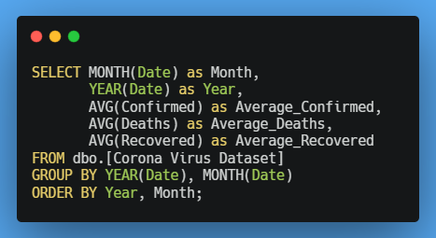
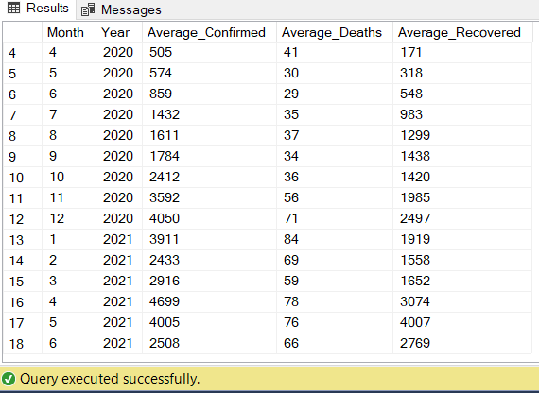
Data Exploration and Analysis
Find the monthly average for confirmed, deaths, recovered

Slide 12
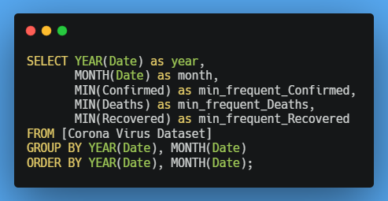
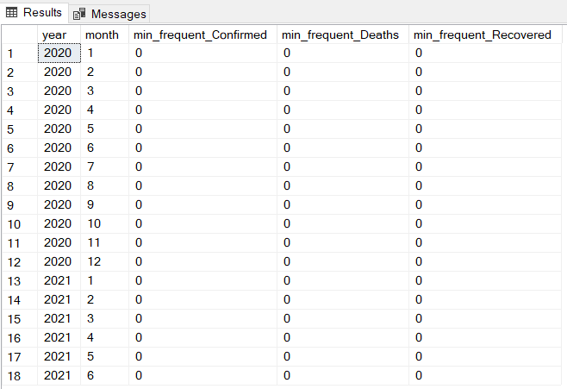
Data Exploration and Analysis
Find minimum values for confirmed, deaths, recovered per year

Slide 13
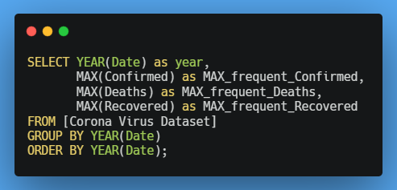

Data Exploration and Analysis
Find maximum values of confirmed, deaths, recovered per year

Slide 14
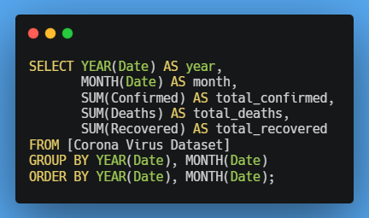
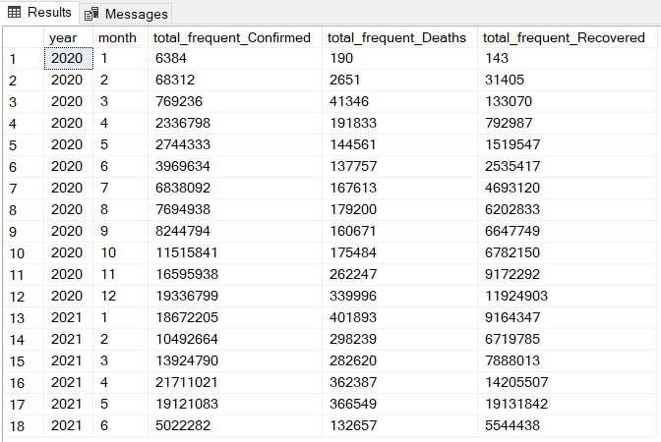
Data Exploration and Analysis
The total number of case of confirmed, deaths, recovered each month

Slide 15
169,065,144
Total Confirmed cases

Slide 16
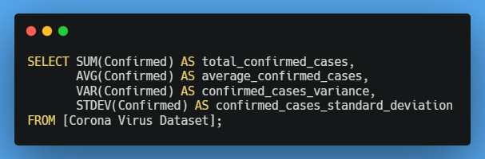
Data Exploration and Analysis
Check how coronavirus spread out with respect to confirmed case

Slide 17
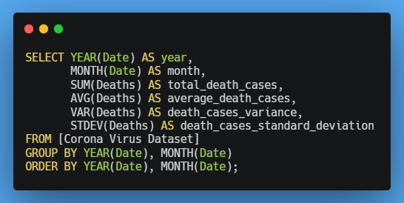
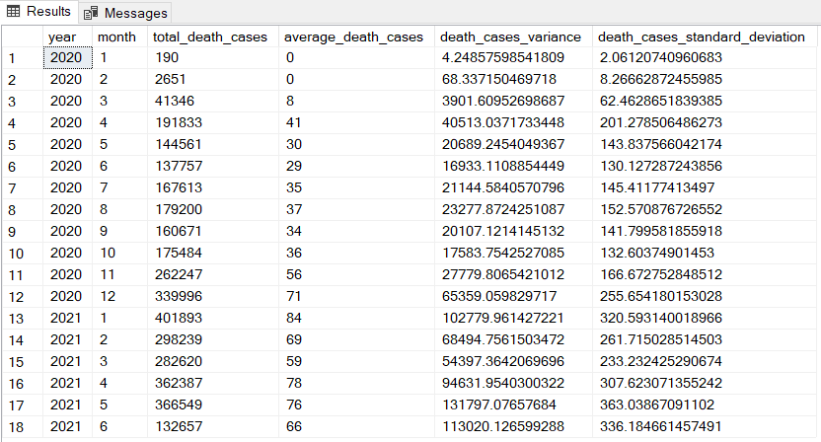
Data Exploration and Analysis
Check how coronavirus spread out with respect to death case per month

Slide 18
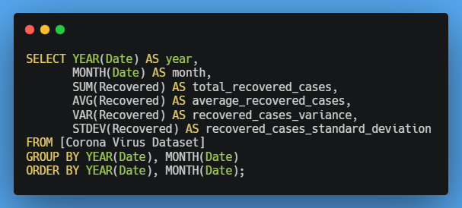
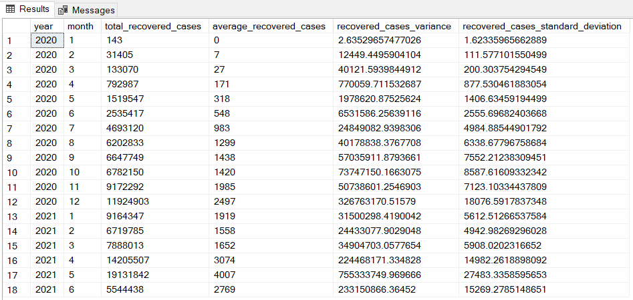
Data Exploration and Analysis
Check how coronavirus spread out with respect to recovered case

Slide 19

FINDINGS
Country having highest number of the Confirmed case
334,619,82 Confirmed cases in U.S

Slide 20
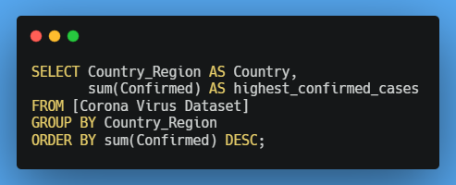

Data Exploration and Analysis
Find Country having highest number of the Confirmed case

Slide 21
FINDINGS
Country having lowest number of the death case
Marshall Islands
Samoa
Dominica
Kiribati

Slide 22
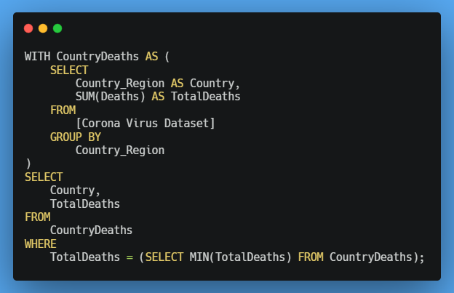
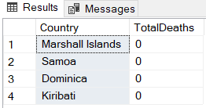
Data Exploration and Analysis
Country having lowest number of the death case

Slide 23
FINDINGS
Top 5 countries having highest recovered case
India
Brazil
US
Turkey
Russia

Slide 24
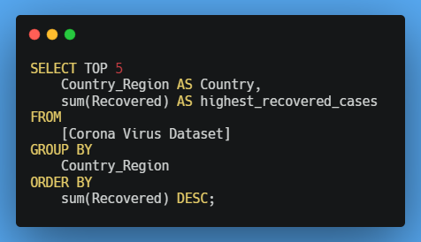
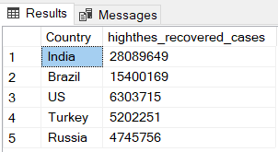
Data Exploration and Analysis
Top 5 countries having highest recovered case

Slide 25
Insights

Slide 26
Insights
COVID-19 Pandemic Duration: January 22, 2020, to June 13, 2021.
India Leads in Recovered Cases then Brazil.
Lowest Death Counts: Samoa, Dominica, Kiribati, and the Marshall Islands.
Highest Confirmed COVID-19 Cases was in United States.
Peak Recovered Cases: April 2021.
Peak Death Rate: January 2021.

Slide 27
Summary

Slide 28
Summary
Data Gathering:
Collection of data from multiple sources including hospitals, health departments, and research institutes.
Gathering information on confirmed cases, deaths, recoveries, and demographic details.
Data Cleaning:
Removing inconsistencies, errors, and missing values from the collected data.
Ensuring the accuracy of the information for analysis.
Exploratory Analysis:
Utilizing SQL queries to uncover patterns and trends within the data.
Investigating factors such as age and gender to understand their influence on outcomes.
Aggregation:
Summarizing key metrics such as total cases, deaths, and recovery rates.
Aggregating data for different countries, regions, and time periods to compare the virus impact and track its progression.

Slide 29
Thank You

